Slide 1
06 Model Evaluation

Slide 2
Lecture Plan
Background Knowledge
Evaluation Methods
Hold-Out
Cross-Validation
Evaluation Metrics
Classification Metrics
Regression Metrics

Slide 3
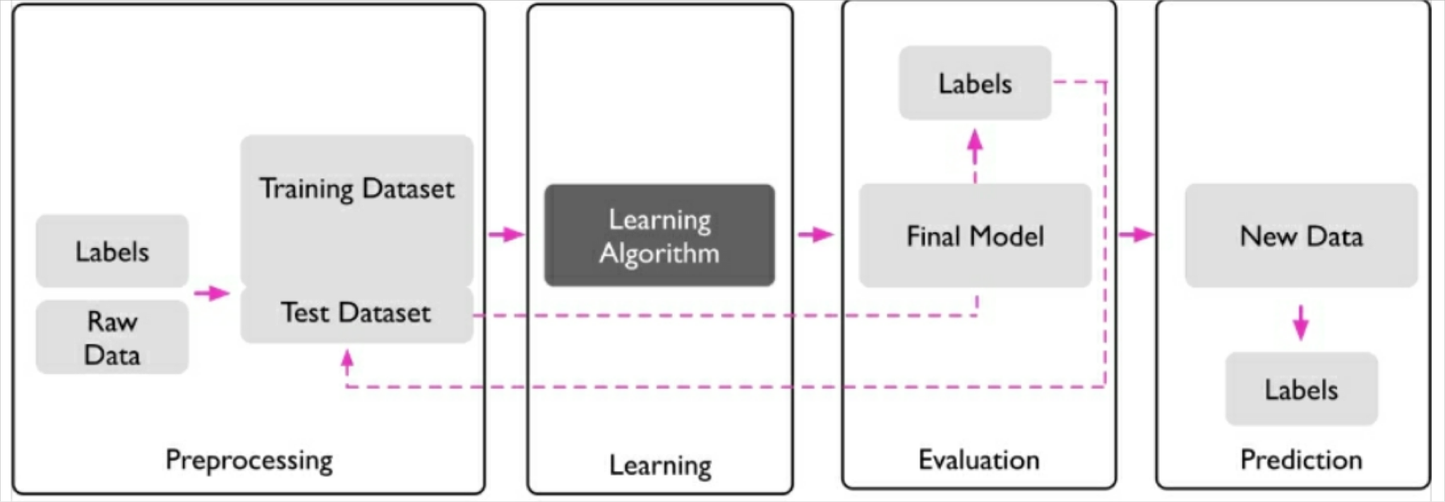
Machine Learning Workflow
Preprocessing: getting data into shape
Learning: selecting an algorithm and training models
Evaluation: evaluating models
Prediction: predicting unseen data instances

Slide 4
Background Knowledge

Slide 5
Background
Model parameters & model hyperparameters
Overfitting & underfitting
Variance & bias

Slide 6
Model Parameters
A model parameter is internal to the model.
They are estimated or learned from data.
They are not set manually by the practitioner.
They are saved as part of the learned model.
Examples
The coefficients in a linear/logistic regression.
The support vectors in a support vector machine.
The weights in an artificial neural network.

Slide 7
Model Hyperparameters
A model hyperparameter is external to the model.
They are used to help estimate model parameters.
They are specified by the practitioner.
They are tuned in an iterative process.
Examples
The k in k-nearest neighbors.
The C (penalty) in support vector machines.
The learning rate in artificial neural networks.

Slide 8
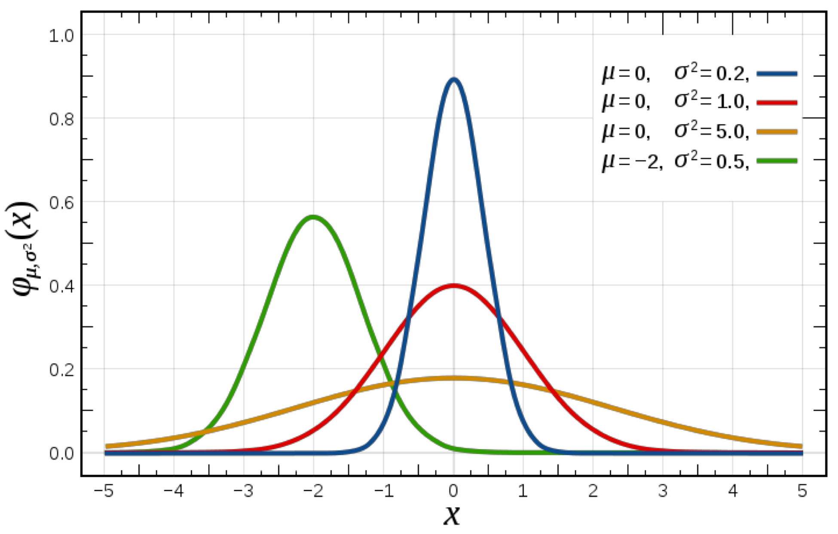
Model Parameters & Hyperparameters
Statistics
Gaussian distribution has two parameters.
Mean (𝜇) and standard deviation (𝜎)

Slide 9
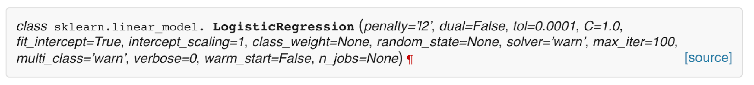
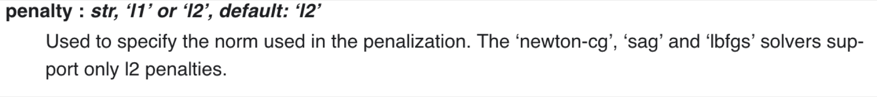
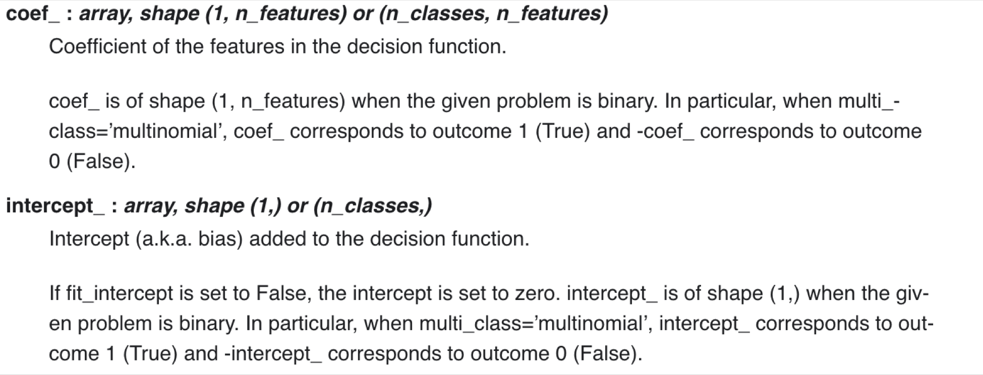
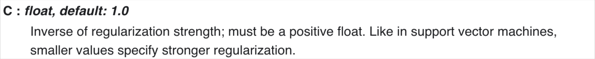
Model Parameters & Hyperparameters
Computer Science
Parameters are passed to a function.
hyperparameters
parameters
http://scikit-learn.org/stable/modules/generated/sklearn.linear_model.LogisticRegression.html

Slide 10
Overfitting
Variance measures the consistency (or variability) of the model prediction for a particular sample instance.
분산 : 모델 예측의 일관성을 측정
If a model is of high variance, we can say that the model is sensitive to the randomness.
분산이 높으면 임의성에 민감하다. (분산 크면 오버피팅 야기)
A model captures the patterns in the training data well, but fails to generalize well to unseen data (test data).
모델이 학습 데이터를 잘 학습하면 테스트 데이터에 대한 일반화는 잘 못할수도
The reason of overfitting is that the model is too complex.

Slide 11
Underfitting
Bias measures how far off the predictions are from the correct values.
편향은 예측이 얼마나 바른 값에서 떨어져 있는지
Bias is a measure of systematic error that is not due to randomness.
임의성이 아닌 오차
A model is not able capture the patterns in the training data well and suffers from low performance on unseen data (test data).
패턴을 잘 파악하지 못하고, 테스트 데이터에 대해서도 낮은 성능
Underfitting is caused when the model is too simple.

Slide 12
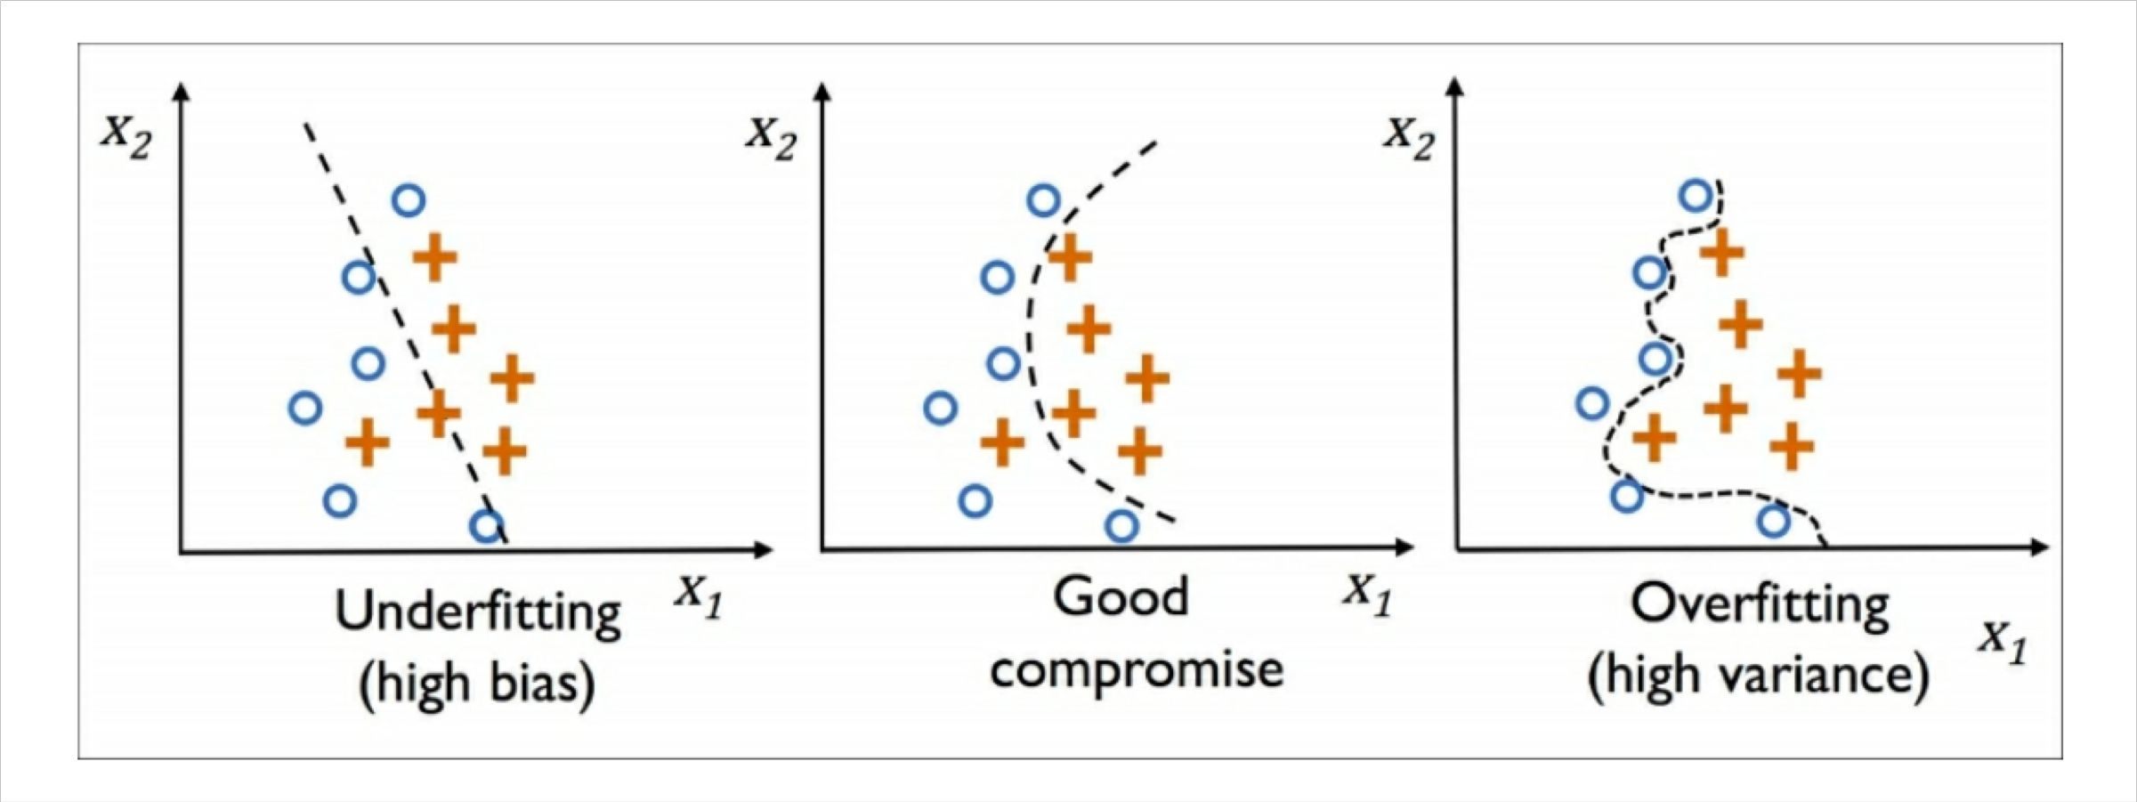
Overfitting & Underfitting
Both fail to generalize well to unseen data because the model is either too complex or too simple.

Slide 13
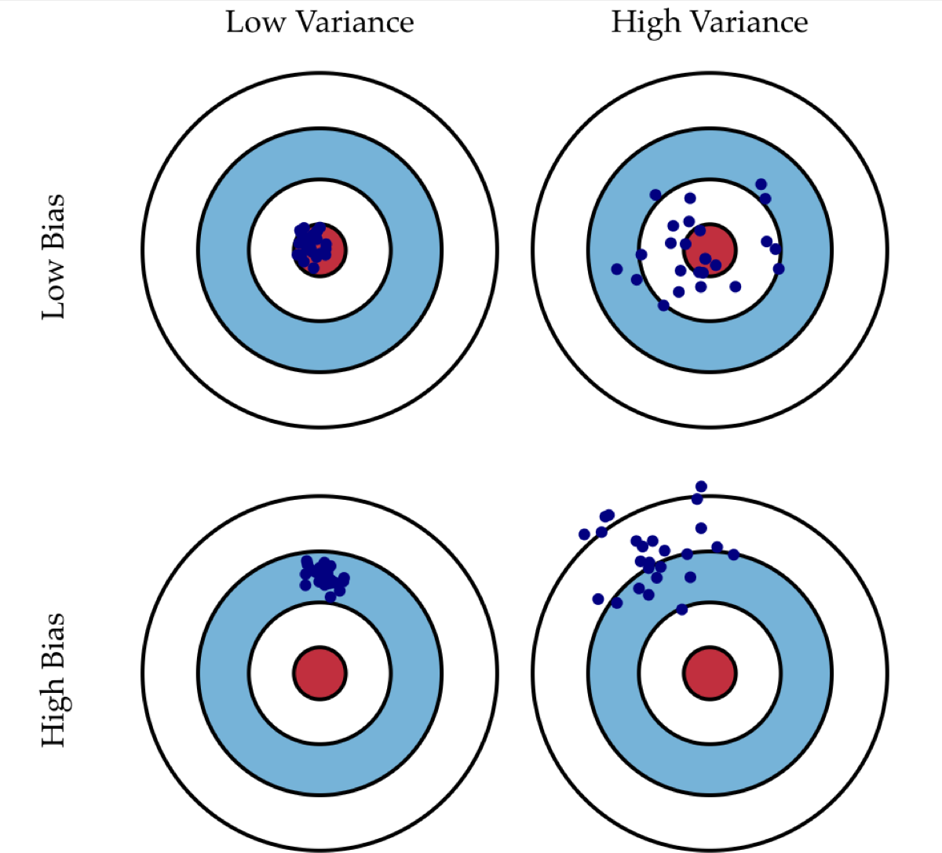
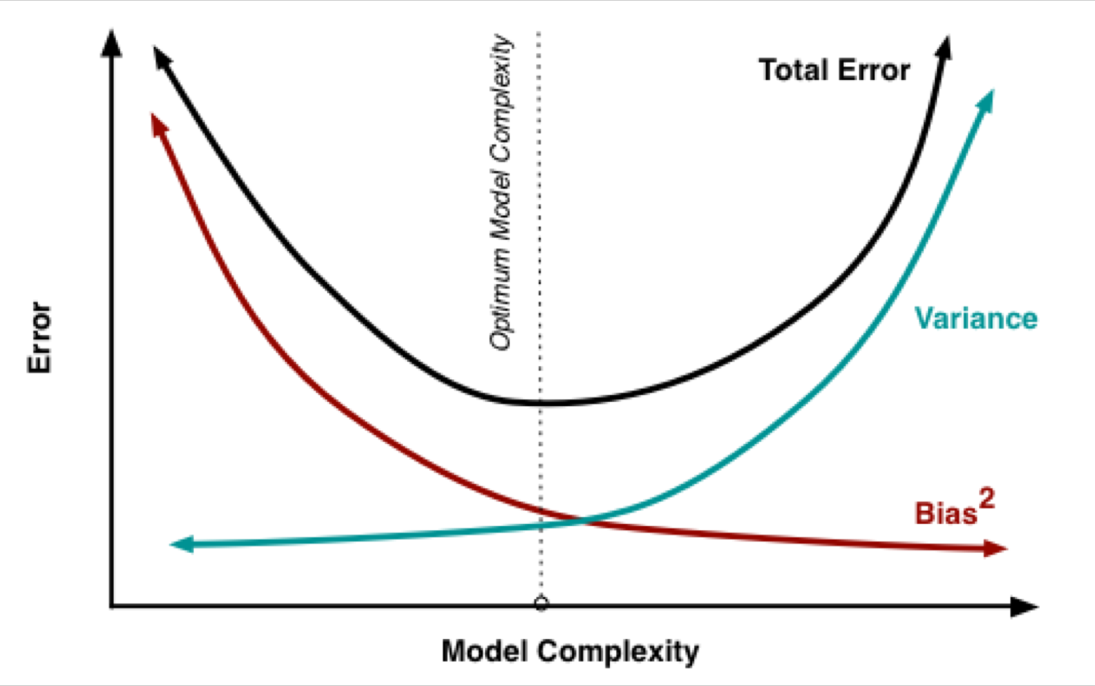
Bias-Variance Tradeoff
We need to find the right/good balance without overfitting and underfitting the data.

Slide 14
Evaluation Methods

Slide 15
Hold-Out (Training & Test)
An evaluation method that partitions the original dataset into subsets, in which a subset (test set) is only used for evaluation.
원래의 데이터셋을 하위 집합으로 분할하는 방법. 서브셋은 평가에 사용
Two subsets
Training set to train a model
Test set to test it.
In typical machine learning, we perform model selection.
Given a classification problem and a training algorithm, we want to select the optimal values of hyperparameters.
분류 문제와 훈련 알고리즘이 주어지면 하이퍼파라미터의 최적 값을 선택하려고 한다.

Slide 16
Hold-Out (Training,Validation, & Test)
During model selection, same test set is reused over and over again.
모델을 선택하는 동안 동일한 테스트셋이 계속 재사용된다.
It will become part of training data and thus, the model will be likely to overfit.
훈련 데이터의 일부가 되기 때문에 과적합될 수 있다.
A better approach is to split the dataset into a training set, a validation set, and a test set.
더 나은 접근방식으로 데이터셋을 훈련 세트, 검증 세트 및 테스트 세트로 분할하는 것이다.
Training set is used to fit the parameters of the model. 훈련셋 : 파라미터 맞추는데 사용
Validation set is used to tune the hyperparameters of a model.검증셋 : 하이퍼파라미터 조정
Test set is used to estimate a model’s generalization performance. 테스트 : 일반화 성능 추정

Slide 17
Hold-Out (Training,Validation, & Test)
A test set is also called a hold-out dataset because it is never used during the training and model selection steps.
테스트 셋은 훈련 및 모델 선택 단계에서 사용되지 않기 때문에 홀드아웃 데이터 세트라고도 한다
A test set is used to provide an evaluation of a final model fitted on the training set and tuned on the validation set.
테스트 세트는 훈련 세트에 적합하고 검증 세트에서 조정된 최종 모델의 평가를 제공하는 데 사용된다.
We can obtain a less biased estimate of its ability to generalize to new data.
새로운 데이터로 일반화하는 능력에 대해 덜 편향된 추정치를 얻을 수 있다.

Slide 18
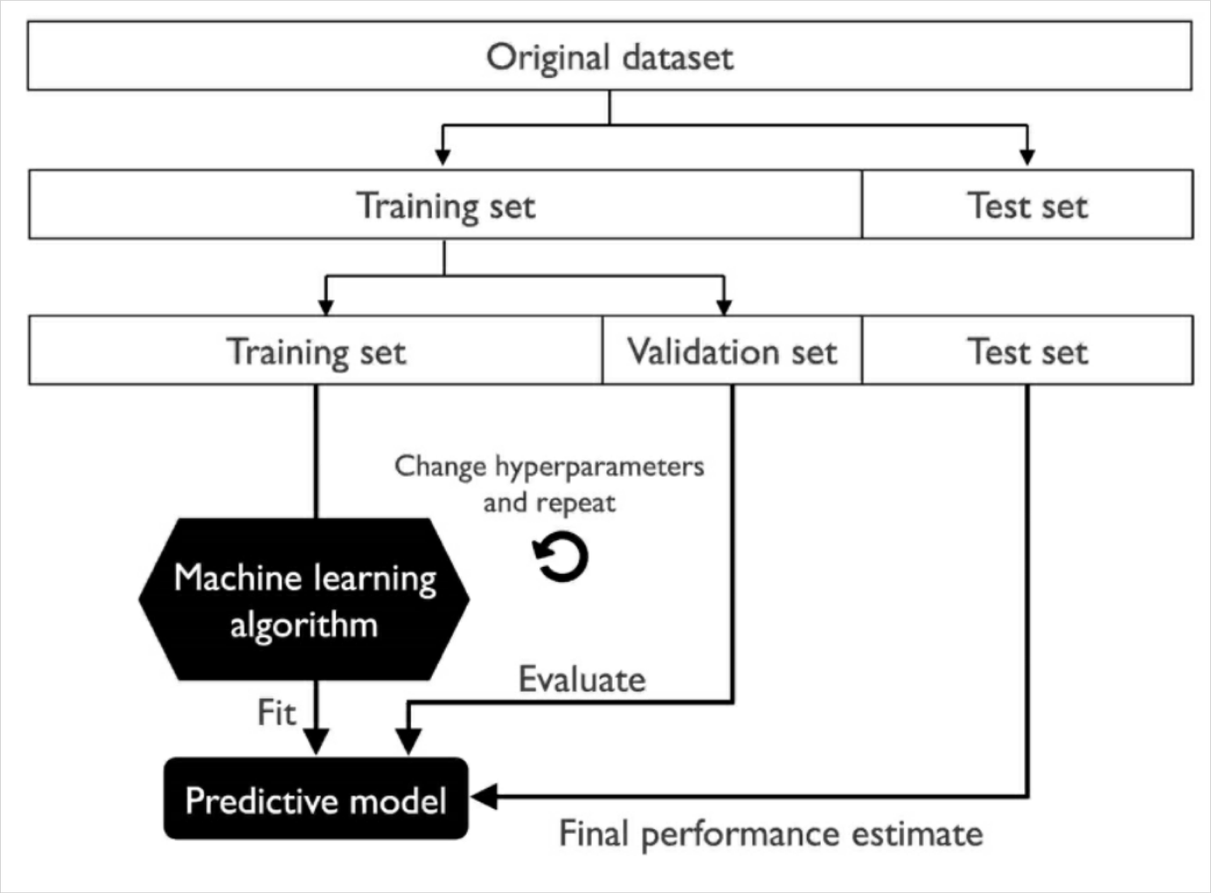
Hold-Out (Training,Validation, & Test)
Workflow

Slide 19
Disadvantages of Hold-Out
By partitioning the available data into three subsets, we drastically reduce the number of samples which can be used for learning the model.
사용 가능한 데이터를 세개의 서브셋으로 나누면서, 모델 학습에 쓸 수있는 샘플 수를 줄인다.
Training set
Model 1
Training set
Validation set
Model 2

Slide 20
Disadvantages of Hold-Out
The performance estimate may be very sensitive to how we partition the training set into the training and validation subsets.
분할 하는 방법이 무엇인지에 따라서 민감하다.
Training set
parameter setting 1
parameter setting 2
…
parameter setting n
Best parameter setting in split 1
Split 1
Training set
Validation set
Which one to choose?
parameter setting 1
parameter setting 2
…
parameter setting n
Split 2
Validation set
Training set
Best parameter setting in split 2

Slide 21
Cross-Validation (CV)
Split the dataset into a training set and a test set.
A validation set is no longer needed.
트레이닝셋과 테스트셋으로 나누고 검증셋은 필요 없다.
The test set is held out for final evaluation.
테스트 셋은 최종 평가에만 쓰인다.
A training set is split into multiple subsets and every subset is used for training and validation.
훈련 셋은 다시 여러 하위 집합으로 분류되고, 이것들은 훈련과 검증에 사용된다.

Slide 22
K-fold Cross-Validation
Randomly split the training dataset into k folds without replacement, where
훈련데이터 셋을 교체없이 무작위로 k 개로 분할한다.
k-1 folds are used for the model training, and
one fold is used for performance evaluation.
This procedure is repeated k times so that we obtain k models and k performance estimates.
이걸 k번 반복하여 k 모델과 k 성능 추정치를 얻는다.
Then, calculate the average performance of the models.
모델의 평균 성능을 계산합니다.
After finding satisfactory hyperparameter values, retrain the model on the complete training set and obtain a final performance estimate using the test set.
만족스러운 하이퍼파라미터 값을 찾은 후에 전체 훈련 세트에서 모델을 다시 훈련시키고 테스트 세트를 사용하여 최종 성능 추정치를 얻습니다.

Slide 23
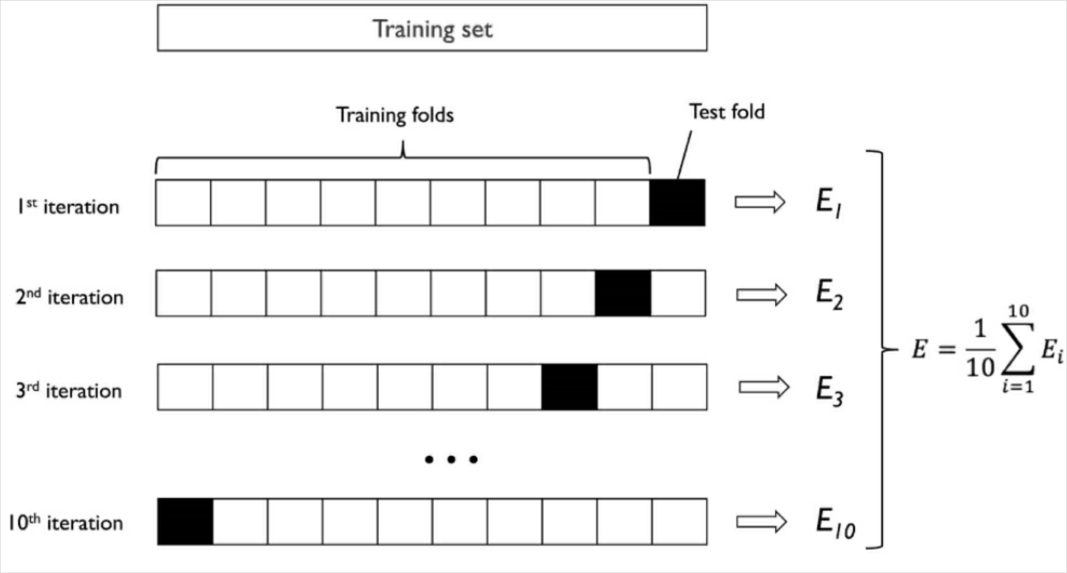
K-fold Cross-Validation
Example (10-fold cross-validation)

Slide 24
K-fold Cross-Validation
Choosing K
Empirical evidence shows, a good standard value for k is 10.
경험적으로 좋은 값 10
If the training set is small, we can increase the value of k so that more training data will be used in each iteration.
훈련셋이 작으면 k 를 더 키워서 훈련셋을 더 크게
Reduce underfitting because more information will be provided.
Increase overfitting because the training folds will be more similar to each other.
If we are working with large datasets, we can choose a smaller value for k.
데이터셋이 더 크면 k 를 더 작게 선택할 수 있음
Can reduce computational cost of refitting and evaluating the model on the different folds.
K 작으면 계산량은 적어진다. 다시 학습하고 평가하는 것이 줄어들어서

Slide 25
Cross-Validation
K-fold
Divides all the samples in K groups of samples.
Repeated K-fold
Repeats K-fold n times.
Used when one requires to run K-fold n times, producing different splits in each repetition.
Leave One Out (LOO)
Each learning set is created by taking all the samples except one, the test set being the sample left out.
For n samples, we have n different training sets and n different test sets.
Does not waste much data as only one sample is removed from the training set.
https://m.blog.naver.com/ckdgus1433/221599517834

Slide 26
Cross-Validation
Leave P Out (LPO)
Similar to Leave One Out, it creates all the possible training/test sets by removing p sample from the complete set.
For n samples, this produce 𝐶(𝑛, 𝑝) train-test pairs.
For even moderately large n, LPO can become computationally infeasible.
Stratified K-fold
In stratified k-fold cross-validation, the class proportions are preserved in each fold to ensure that each fold is representative of the class proportions in the training dataset.
주로 classification 중 label 분포가 다른 경우 사용!

Slide 27

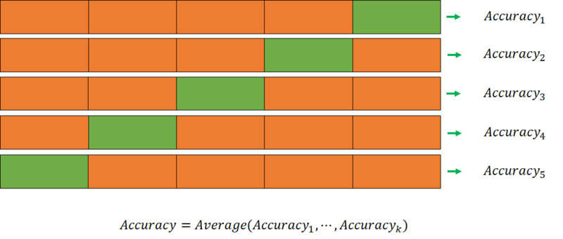
Hold-out
K-fold cv

Slide 28
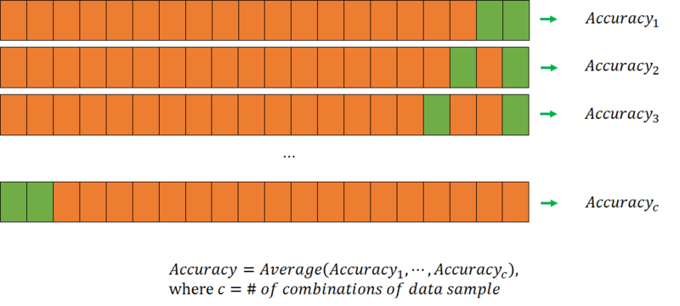
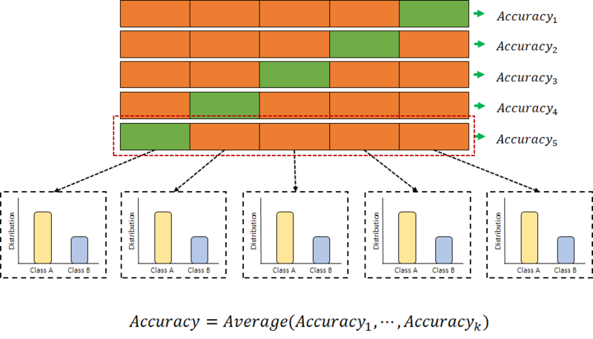
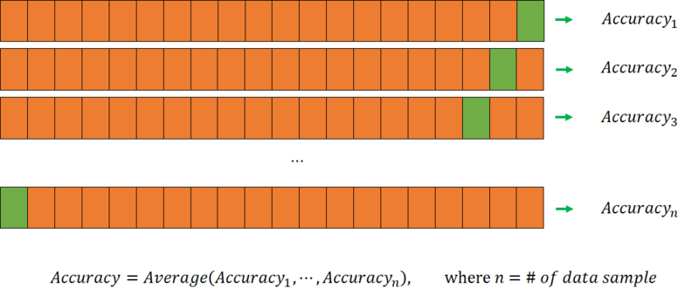
LPOCV
Stratified k-fold cv
LOOCV

Slide 29
Model Tuning

Slide 30
Learning & Validation Curves
Diagnosing overfitting & underfitting
Learning Curves
Addressing overfitting & underfitting
Validation Curves

Slide 31
Learning Curves
learning curves diagnose whether a learning algorithm has a problem with overfitting (high variance) or underfitting (high bias).
학습곡선은 학습 알고리즘에 오버피팅 언더피팅 문제를 찾게 한다.
By plotting the model training and validation accuracies as functions of the training set size, we can easily detect whether the model suffers from high variance or high bias.
모델 훈련 및 검증 정확도를 훈련셋 크기의 함수로 플라팅 함으로써 모델이 이러한 문제를 겪는지 감지 가능하다.

Slide 32
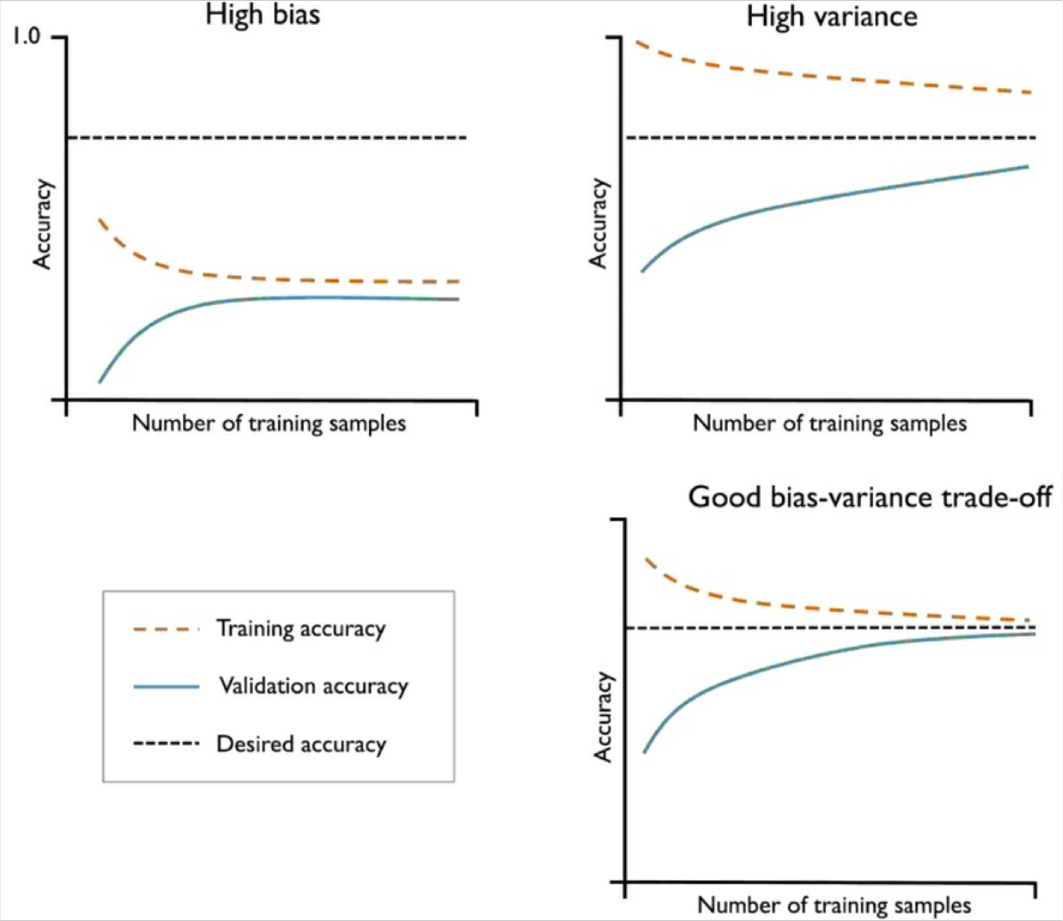
Learning Curves
High bias (underfitting)
Low training and validation accuracy
Solution: collect additional features, decrease the degree of regularization
High variance (overfitting)
The large gap between the training and validation accuracy.
Solution: collect more training data, reduce complexity of the model, increase the regularization parameter.

Slide 33
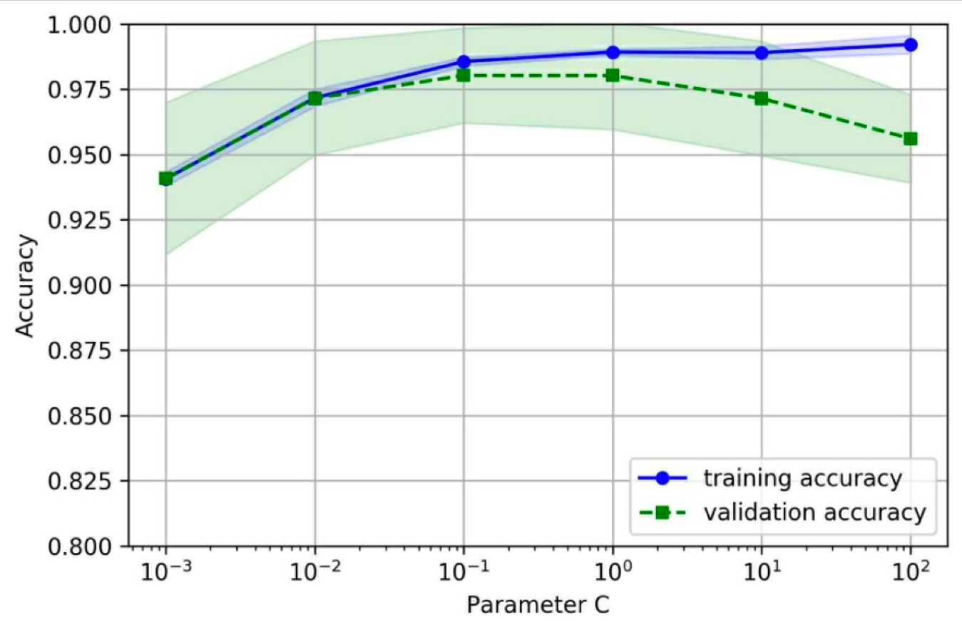
Validation Curves
A plot of training and test accuracies as functions of values of the model hyperparameters.
Example
The inverse regularization parameter C in logistic regression
Large values of C means lowering the strength of regularization.
For large values of C, the model tends to overfit.
For small values of C, the model tends to underfit.
The sweet spot appears to be between 0.01 and 0.1.
Acceptable training and validation accuracy.
Acceptable gap between the two.
로지스틱 회귀에서 역 정규화 매개변수 CC 값이 크면 정규화 강도가 낮아집니다.
C 값이 크면 모델이 과적합되는 경향.
C 값이 작으면 모델이 과소적합되는 경향
스위트 스폿은 0.01에서 0.1 사이인 것으로 보입니다.
허용 가능한 교육 및 검증 정확도.
둘 사이의 허용 가능한 간격.

Slide 34
Hyperparameter Optimization
Hyperparameter optimization or tuning is the problem of choosing a set of optimal hyperparameters for a learning algorithm.
최적의 하이퍼파라미터 세트를 선택하는 문제
Grid Search
Exhaustively considers all parameter combinations.
모든 조합을 철저하게 고려
Randomized Search
Draw random parameter combinations from sampling distributions.
샘플링 분포에서 임의의 매개변수 조합을 그린다.

Slide 35
Grid search
A brute-force exhaustive search paradigm.
Advantages
Can find the optimal set of parameters
Disadvantages
The evaluation of all possible parameter combinations is computationally very expensive.
Example (Support Vector Classifier)
param_grid = [
{'C': [1, 10, 100, 1000], 'kernel': ['linear']},
{'C': [1, 10, 100, 1000], 'gamma': [0.001, 0.0001], 'kernel': ['rbf’]}
]

Slide 36
Randomized Search
Not all parameter values are tried out, but rather a fixed number of parameter settings is sampled from the specified distributions.
모든 매개변수 값이 시도되는 것은 아니지만 고정된 수의 매개변수 걸정이 지정된 분포에서 샘플링 된다.
Advantages
Independent of the number of hyperparameters and possible values.
Example
{'C': scipy.stats.expon(scale=100), 'gamma': scipy.stats.expon(scale=.1), 'kernel': ['rbf’]}

Slide 37
Nested Cross-Validation
Using k-fold cross-validation in combination with grid search is a useful approach for fine-tuning the performance of a machine learning model.
If we want to select among different machine learning algorithms, another recommended approach is nested cross-validation.
GridSearchCV를 사용할 때 데이터를 train set와 test set로 한 번만 나누기 때문에, 결과가 불안정하고 테스트 데이터의 분할에 크게 의존합니다.
이런 문제를 해결하기 위해 cross-validation 방식을 사용할 수 있습니다.
이를 nested cross-validation중첩교차검증이라 합니다.

Slide 38
Nested Cross-Validation
Nested cross-validation is used for comparing and selecting among different machine learning algorithms.
서로다른 알고리즘을 비교 및 선택하는 데에 사용
An outer k-fold cross-validation is used to loop to split the data into training and test folds.
외부 k 폴드 크로스 밸리데이션은 데이터를 훈련, 테스트 셋으로 분리시 사용
An inner loop is used to select the model using k-fold cross-validation on the training fold.
내부 루프는 k 폴드 교차검증을 사용하여 모델 선택에 사용
After model selection, the test fold is then used to evaluate the model performance.
모델 선택 후 테스트 폴드는 모델 성능을 평가하는데 사용

Slide 39
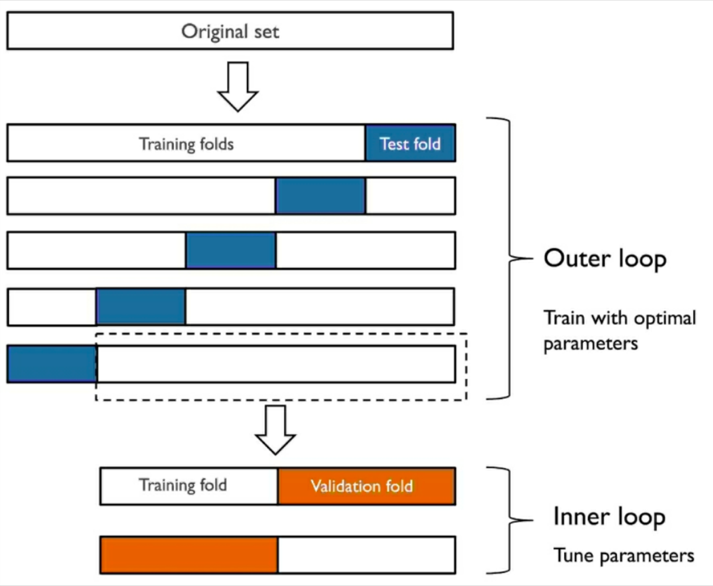
Nested Cross-Validation
5 X 2 cross-validation

Slide 40
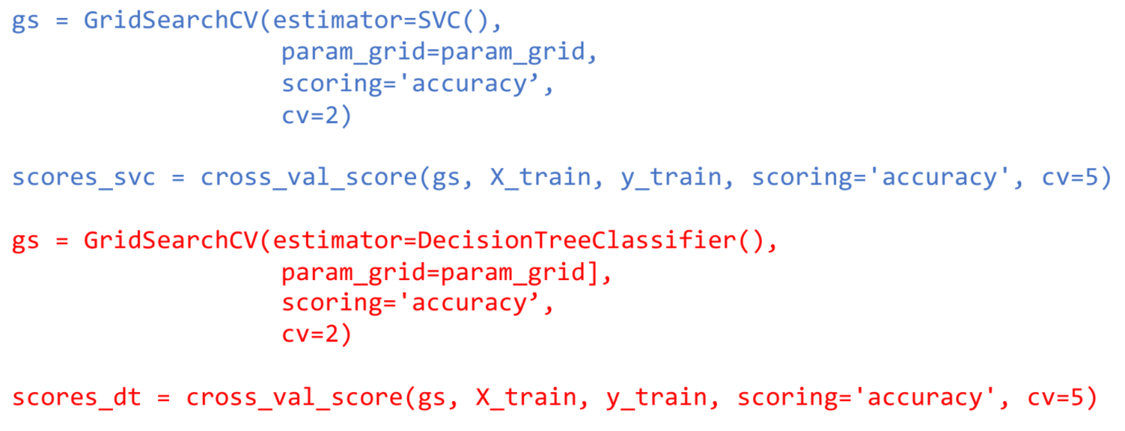
Nested Cross-Validation
Code

Slide 41
Evaluation Metrics - Classification

Slide 42
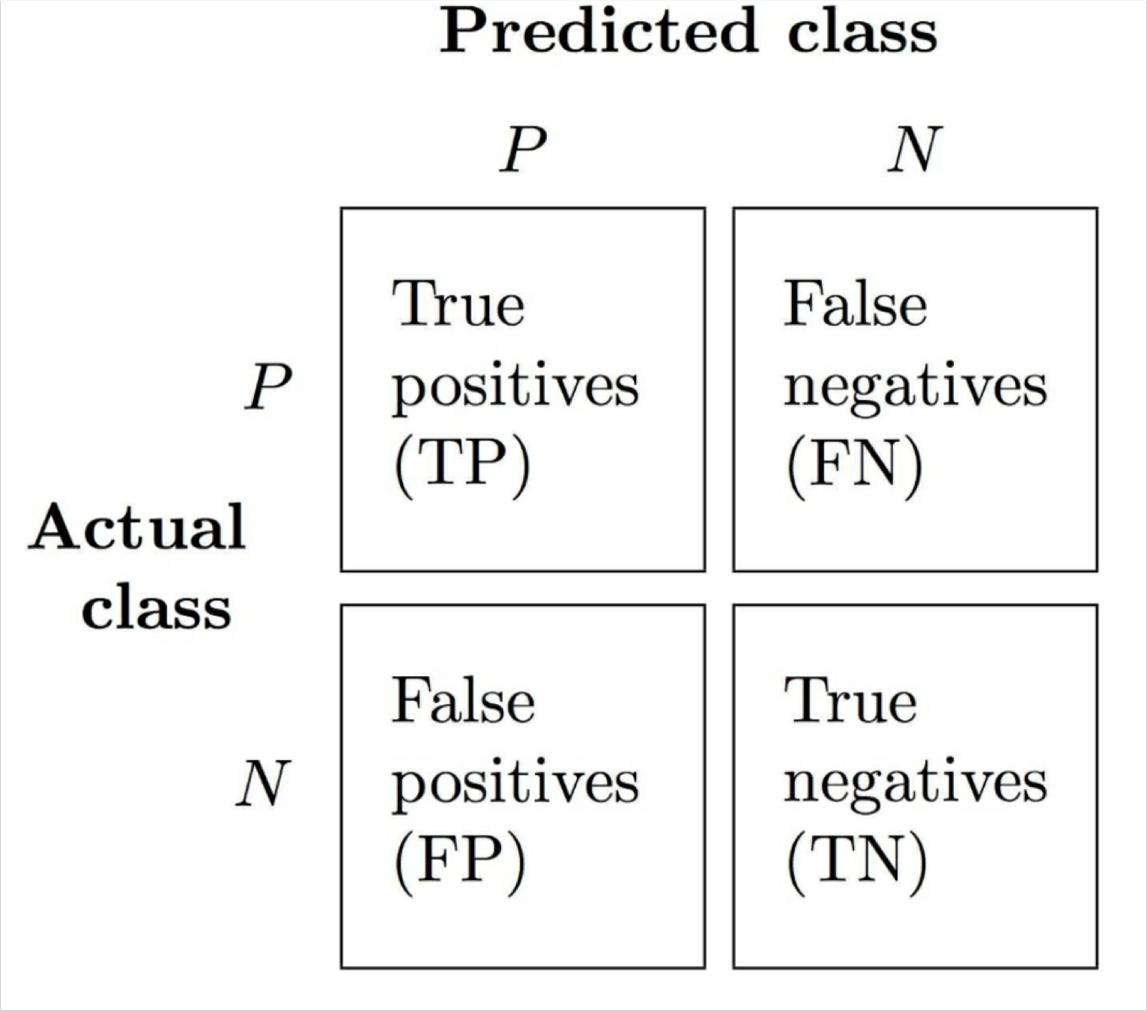
Confusion Matrix
True positive: predicted P & actual P
True negative: predicted N & actual N
False positive: predicted P & actual N
Type I error
False negative: predicted N & actual P
Type II error

Slide 43
Confusion Matrix
100
5 105
𝐹𝑃&𝐹𝑛
Error: 𝐸𝑅𝑅 =
𝐹𝑃&𝐹𝑛&𝑇𝑃&𝑇𝑛
The rate of false predictions
(10 + 5) / 165 = 0.09
10
50 60
110
55
𝑇𝑃&𝑇𝑛
Accuracy: 𝐴𝐶𝐶 = _{𝐹𝑃&𝐹𝑛&𝑇𝑃&𝑇𝑛} = 1 − 𝐸𝑅𝑅
The rate of true predictions
(100 + 50) / 165 = 0.91

Slide 44
Confusion Matrix
𝑇𝑃
Precision: 𝑃𝑅𝐸 =
100 / (100 + 10) = 0.91
𝑇𝑃'𝐹𝑃
𝑇𝑃
Recall: 𝑅𝐸𝐶 =
100 / (100 + 5) = 0.95
100
5 105
𝑇𝑃'𝐹𝑛
F1-score: 𝐹1 = 2
^{𝑃𝑅𝐸×𝑅𝐸𝐶}
10
50 60
^{𝑃𝑅𝐸+𝑅𝐸𝐶}
2 * (0.91 * 0.95) / (0.91 + 0.95) = 0.93
110
55

Slide 45
Confusion Matrix
In tumor diagnosis, we are more
concerned about the detection of
malignant tumors in order to help a patient with the appropriate treatment.
It is also important to decrease the
number of benign tumors that were incorrectly classified as malignant.
100
5 105
So we don’t want to
miss malignant tumors
misclassify benign tumors as malignant.
10
50 60
110
55

Slide 46
Confusion Matrix
True positive rate (sensitivity, recall, probability of detection)
𝑇𝑃𝑅 =
𝑇𝑃
𝑇𝑃'𝐹𝑛
e.g., how many sick people are correctly identified as having the condition.
100 / (100 + 5) = 0.95
True negative rate (specificity)
𝑇𝑛
100
5 105
𝑇𝑛𝑅 =
𝑇𝑛'𝐹𝑃
e.g., how many healthy people are identified as not having the condition.
50 / (50 + 10) = 0.83
False positive rate (false alarm rate)
10
50 60
𝐹𝑃
= 1 − 𝑇𝑛𝑅
𝐹𝑃𝑅 =
𝐹𝑃'𝑇𝑛
110
55

Slide 47
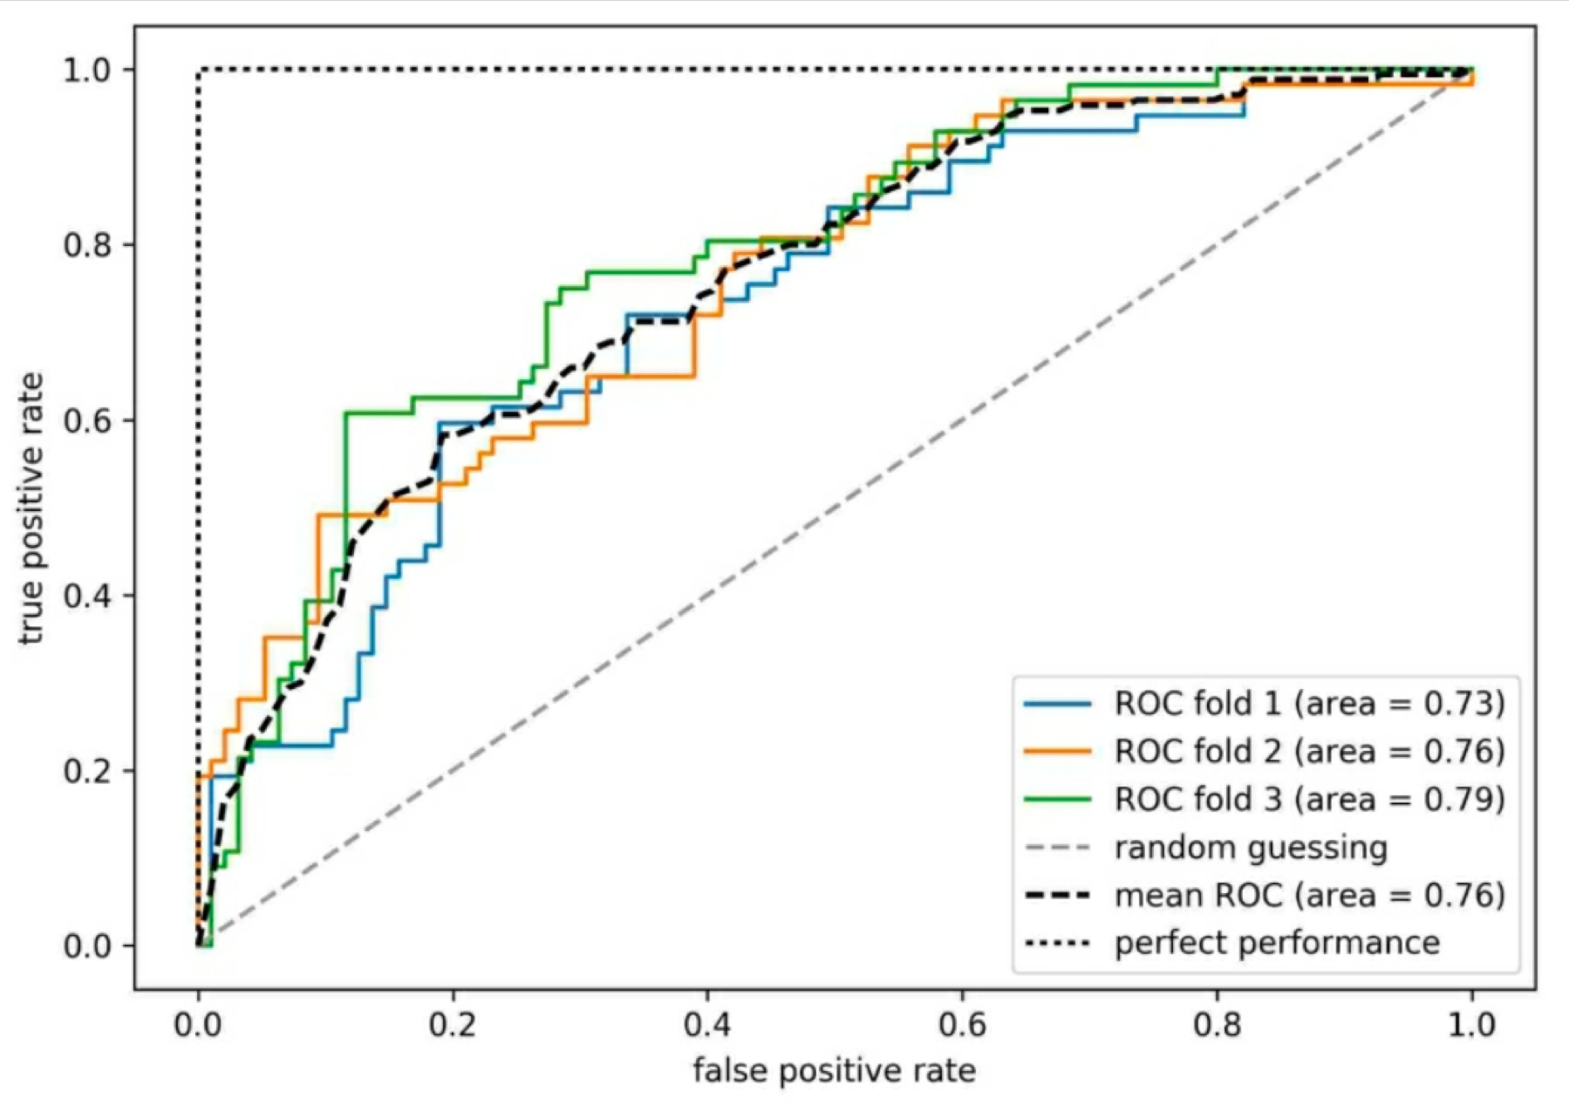
Receiver Operating Characteristic (ROC)
The ROC curve is created by plotting the true positive rate (TPR) against the false positive rate (FPR) at various threshold settings.
ROC 곡선은 다양한 임계값 설정에서 거짓 양성률(FPR)에 대해 참 양성률(TPR)을 도표화하여 생성됩니다.
TPR: probability of detection
FPR: probability of false alarm
The diagonal line is interpreted as random guessing.
A perfect classifier would fall into the top left corner of the graph with a TPR of 1 and a FPR of 0.

Slide 48
Area Under the Curve (AUC)
ROC Area Under the Curve (AUC)
After plotting ROC, we compute ROC AUC to characterize the performance of a classification model.
ROC를 플로팅한 후 분류 모델의 성능을 특성화하기 위해 ROC AUC를 계산합니다.
Range
0.90-1 = excellent (A)
0.80-0.90 = good (B)
0.70-0.80 = fair (C)
0.60-0.70 = poor (D)
0.50-0.60 = fail (F)

Slide 49
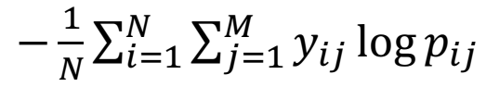
More Classification Metrics
Directly use loss function scores to evaluate a model.
손실함수를 직접 사용하여 모델을 평가
Log loss
Defined as the negative log-likelihood of the true labels given a probabilistic classifier’s predictions.
확률적 분류기의 예측이 주어지면 실제 레이블의 음의 로그를 가능성으로 정의 됩니다.
where 𝑛 is the number of samples, 𝑀 is the number of possible labels, 𝑦_{ij} is a binary indicator of whether or not label 0 is the correct classification for instance 1, 𝑝_{ij} is the model probability of assigning label 0 to instance 1.
손실 함수를 직접 사용하여 모델을 평가합니다. 로그 손실 확률 분류기의 예측이 주어지면 실제 레이블의 음의 로그 가능성으로 정의된다.
Label | A | B | C | D | E
Probability | p1 | p2 | p3 | p4 | p5
http://scikit-learn.org/stable/modules/model_evaluation.html#classification-metrics

Slide 50
Metrics for multiclass classification
One-versus-All Classification
Micro-averaging precision
Useful when weights each instance or prediction equally.
𝑇𝑃₁- ⋯- 𝑇𝑃_{𝑘}
𝑃𝑅𝐸_{𝑚i𝑐𝑟𝑜} =
𝑇𝑃₁- ⋯- 𝑇𝑃_{𝑘}-𝐹𝑃₁- ⋯- 𝐹𝑃_{𝑘}
Macro-averaging precision
Useful when weights all classes equally.
𝑃𝑅𝐸₁- ⋯- 𝑃𝑅𝐸_{𝑘}
𝑘
𝑃𝑅𝐸_{𝑚a𝑐𝑟𝑜} =

Slide 51
Evaluation Metrics - Regression

Slide 52
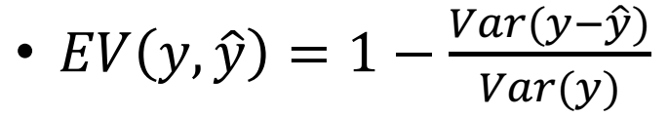
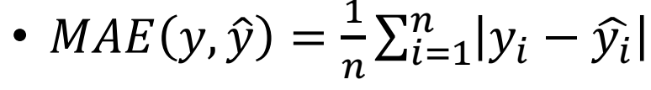
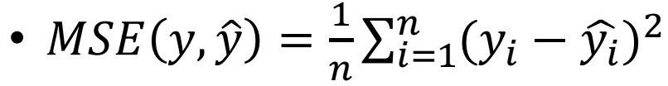

Regression Metrics
Explained Variance
Mean Absolute Error
Mean Squared Error
Mean Squared Logarithmic Error

Slide 53
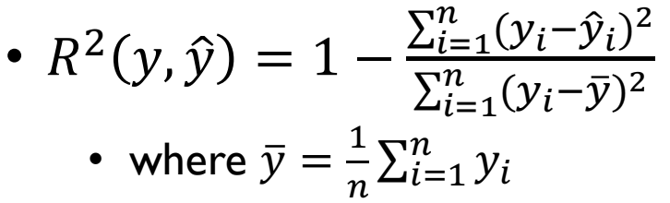
Regression Metrics
R squared (coefficient of determination)
It provides a measure of how well future samples are likely to be predicted by the model.
Best possible score is 1.0 .

